Slide 1
Software Project Management
Software Project Planning:
Creating the Project Plan
Week 3 · Lecture 1 | Chapter 2, Applied Software Project Management (Stellman & Greene)
FALL 2026
Dr. Anam Mustaqeem
anam.mustaqeem@ucp.edu.pk
Office: Cabin #2, F303 Building A
OFFICE HOURS: Wednesday : 09:00 AM- 12:00 PM
Thursday: 09:00 AM- 11:00 AM

Slide 2

Notes:
Opening dua.

Slide 3
Today’s Agenda
Understand the project needs
Create the project plan: its components and who uses it
Statement of work (SOW)
Resource list
Estimates and project schedule
Risk plan: risk planning script and a sample risk plan
Project plan inspection checklist

Slide 4
Understand the Project Needs
Part 1 | Why planning starts from needs, not from urgency

Slide 5

Understand the Project Needs
AN URGENT NEED CAN BE A GOOD MOTIVATOR
But urgency can also be the source of a project’s most difficult problems. Urgency causes people to panic and people will rush into gathering requirements (or, even worse, rush into building the code!) without thoroughly understanding the needs of the people who want the software built.

Slide 6
Understand the Project Needs
If a project manager does not really understand the context in which the software is being built, then the only thing that the project team sees is the urgency; they lose track of the needs.
Unless the team understands the needs that drive the project, they may end up with a narrow focus, causing them to waste time addressing problems that are of little importance to the stakeholders.
It’s easy to build great software that solves the wrong problems, but the only way to build the appropriate software is for everyone in the project to understand and agree on both why and how that software will be built before the work begins. That’s the purpose of project planning.

Slide 7
Create the Project Plan
Chapter 2: Applied Software Project Management by Andrew Stellman

Slide 8
Create the Project Plan
The project plan defines the work that will be done on the project and who will do it. A typical project plan consists of:
  A statement of work that describes all work products (specifications, test plans, code, defect reports, and any other product of work performed over the course of the project) that will be produced and a list of people who will perform that work
  A resource list that contains a list of all resources that will be needed for the product, and their availability
  A work breakdown structure and a set of effort estimates
  A project schedule
  A risk plan that identifies any risks that might be encountered and indicates how those risks would be handled, should they occur

Slide 9
Project Plan - Uses
The project plan is used by many people in the organization.
The project manager uses it to communicate the project’s status to the stakeholders and senior managers, and to plan the team’s activities.
The team members use it to understand the context for the work they are doing.
The senior managers use it to verify that the project’s cost and schedule are reasonable and under control, and that the project is being done in an efficient and cost effective manner.
The stakeholders use it to make sure that the project is on track, and that their needs are being addressed.

Slide 10
Statement of Work
The first component of the project plan is a statement of work (SOW).
This is a detailed description of all of the work products that will be created over the course of the project, including who is responsible for creating each work product.
The description of each work product should contain a reference to any tasks in the project schedule in which it is involved.
The vision and scope document is a useful starting point for the SOW.

Slide 11
Statement of Work vs Vision and Scope
The vision and scope document talks about the rationale for the project (the needs that must be met, the list of users and stakeholders who need it built, etc.)
The SOW simply contains a detailed list of the work that must be done and all of the work products that will be produced.

Slide 12
Statement of Work - Elements
The SOW is included as part of the project plan, but it should be a separate document that can stand on its own. It should contain each of the following:
  The list of features being developed.
  A description of the intermediate deliverable or work product that will be built.
  The estimated effort involved for each work product to be delivered
Notes:
2 This is a list that covers software requirements specifications, design and architecture specifications, class or UML diagrams, code or software packages (divided into separate libraries or modules, if necessary), test plans and test cases, user acceptance plans, and any other document, source code or other work product that will be created. A brief description—no more than a paragraph—is usually sufficient for each one. The SOW also should list any standards or templates that will be used to create the work product.

Slide 13
Resource List
The project plan should contain a list of all resources that will be used on the project.
The list should give each resource a name, a brief one-line description, and the availability and cost (if applicable) of the resource. All resources should be handled in the same way, regardless of type.
Most project management software packages provide a feature to maintain a resource list.

Slide 14
Estimates and Project Schedule
This is usually done in several steps:
  A work breakdown structure (WBS) is defined. This is a list of tasks that, if performed, will generate all of the work products needed to build the software.
  An estimate of the effort required for each task in the WBS is generated.
  A project schedule is created by assigning resources and determining the calendar time required for each task.
The project plan should contain a list of any tasks that are added, changed, or removed, and when those changes occurred. It should also include estimates and a project schedule, including any revisions that were made during the review meetings.

Slide 15
Risk Plan
A Risk Plan is a list of all risks that threaten the project, along with a plan to mitigate some or all of those risks.
Adding a risk plan to a software project plan is an effective way to keep the project from being derailed by uncertainties.
Risk planning for most projects can be done in one meeting, usually in less than two hours. The meeting is led by the project manager, who should select a team similar

Slide 16
Risk Plan
Three Main activities:
  Brainstorm potential risks
  Estimate the impact of each risk
    Estimate two things: a rough estimate of the probability that the risk will occur, and the potential impact of that risk on the project
  Make a mitigation plan
    The team can take any or all of these actions to mitigate a risk: Alter the project plan, Add additional tasks or Plan for risks.

Slide 17
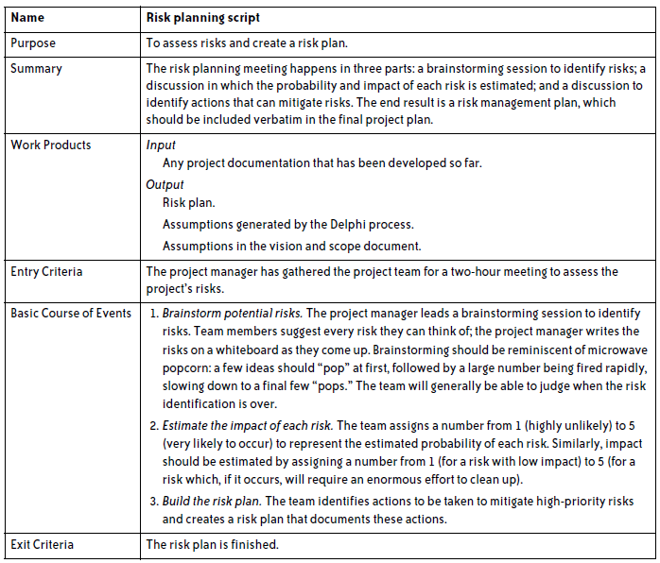
Risk Planning Script

Slide 18
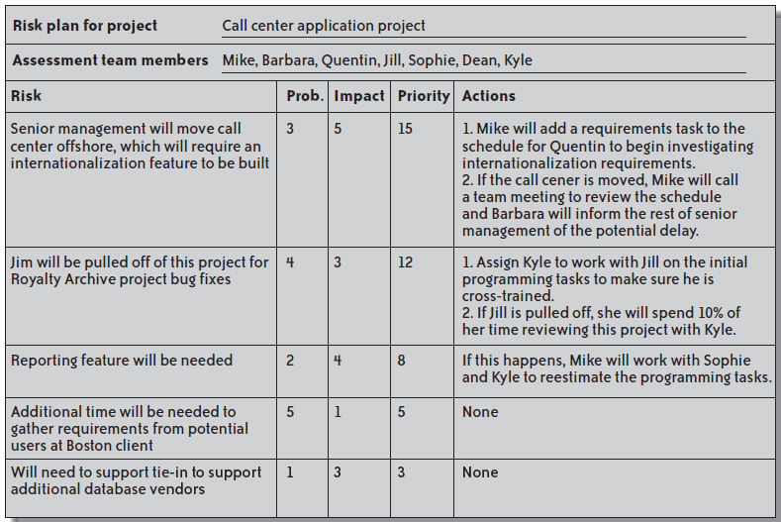
Sample Risk Plan

Slide 19
Project Plan Inspection Checklist
The project plan should be reviewed using this inspection checklist.
Statement of work
  Does the project plan include a statement of work (SOW)?
  Is the SOW complete—does it contain all of the features that will be developed?
  Are all work products represented?
  If estimates are known, have they been included?

Slide 20
Project Plan Inspection Checklist
Resources
  Does the project plan include a resource list?
  Does the resource list contain all resources available to the project?
  Are there any resources known to be assigned to other projects at the same time that they are assigned to this one?
  Have dates that the resources are unavailable (scheduled downtime for machines, vacations for people, times that facilities cannot be booked, etc.) been taken into account?

Slide 21
Project Plan Inspection Checklist
Project schedule
  Does the project plan include a schedule?
  Are there any tasks that are missing or incorrect?
  If a WBS was generated by a Delphi session, does the project schedule reflect all of the tasks that were identified by the team?
  Does each task have a predecessor?
  Is a resource allocated to each task?
  If multiple resources have been assigned to a single task, has the task’s duration been updated properly to reflect that?
  Is there a more efficient way to allocate resources?
  Does the project schedule contain periodic reviews?

Slide 22
Project Plan Inspection Checklist
Risk plan
  Does the project plan include a risk plan?
  Are there any risks that are not in the plan?
  Are there any assumptions that represent risks that should be included in the plan?
  Is each risk prioritized correctly?
  Has the impact of each risk been estimated correctly?
  Have the risks been sufficiently mitigated?

